Slide 1
Speakers and topics
Among the issues on our agenda in Barcelona will be:
Opportunities and challenges of building a high-quality pan-European MGA business
Capacity strategies for optimal flexibility and scalability
Enhancing performance and productivity through AI-powered technologies
Europe’s journey: How the US MGA market – currently five times the size of Europe’s – may offer pointers to the future
Reefs and shoals - navigating European MGA regulation
Liquidity events – practical issues for MGA founders

Slide 2
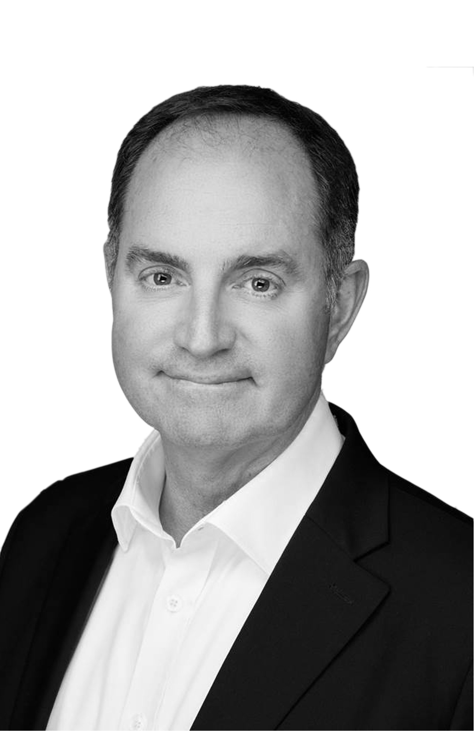
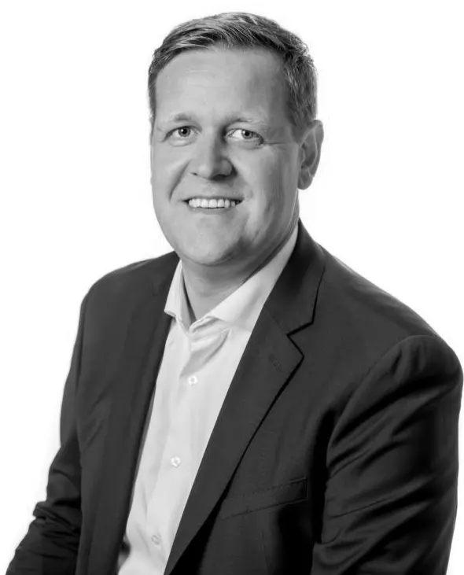
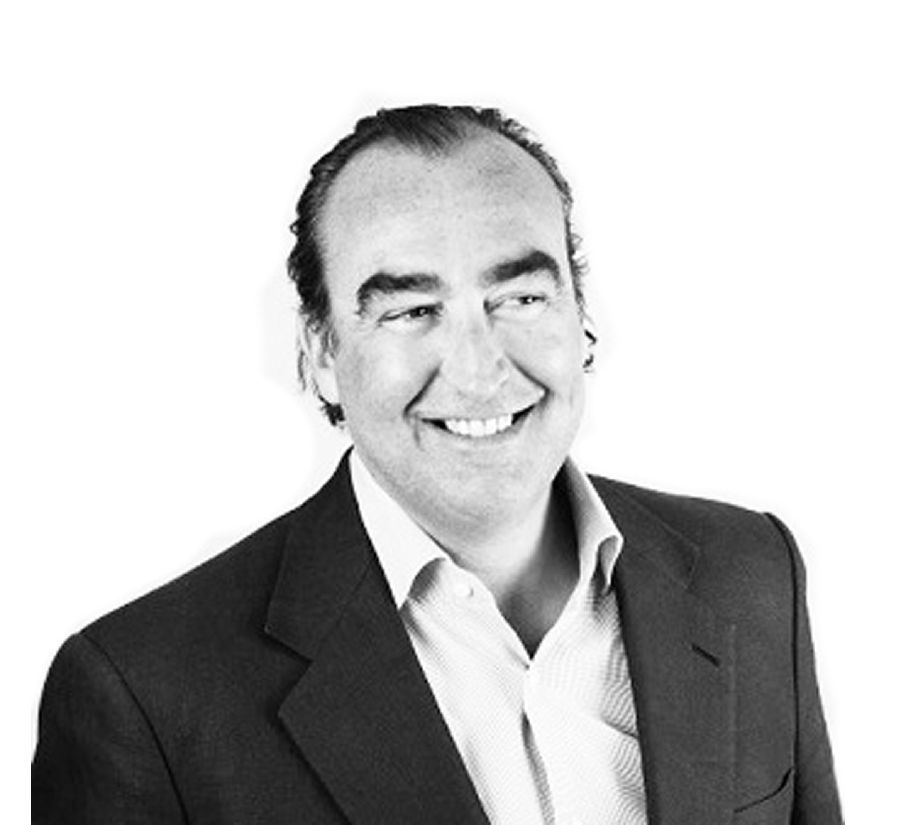
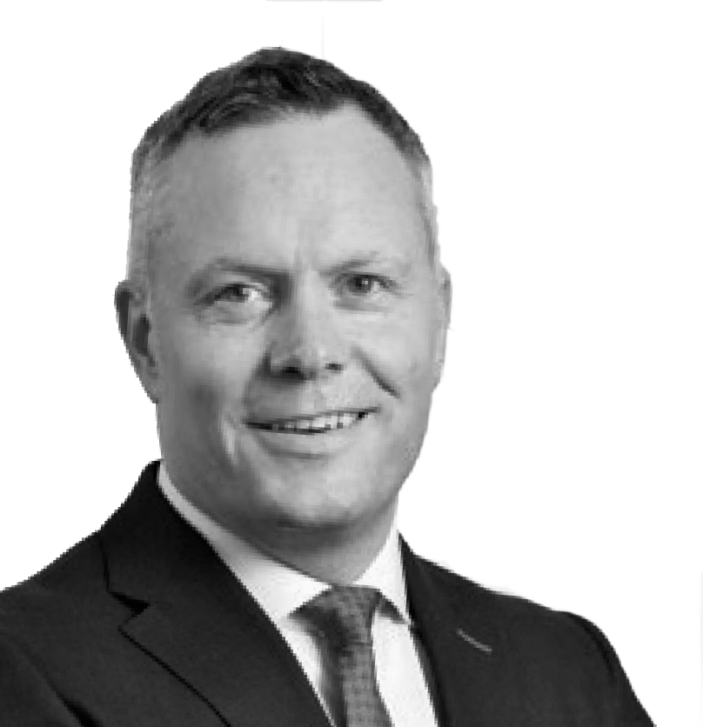
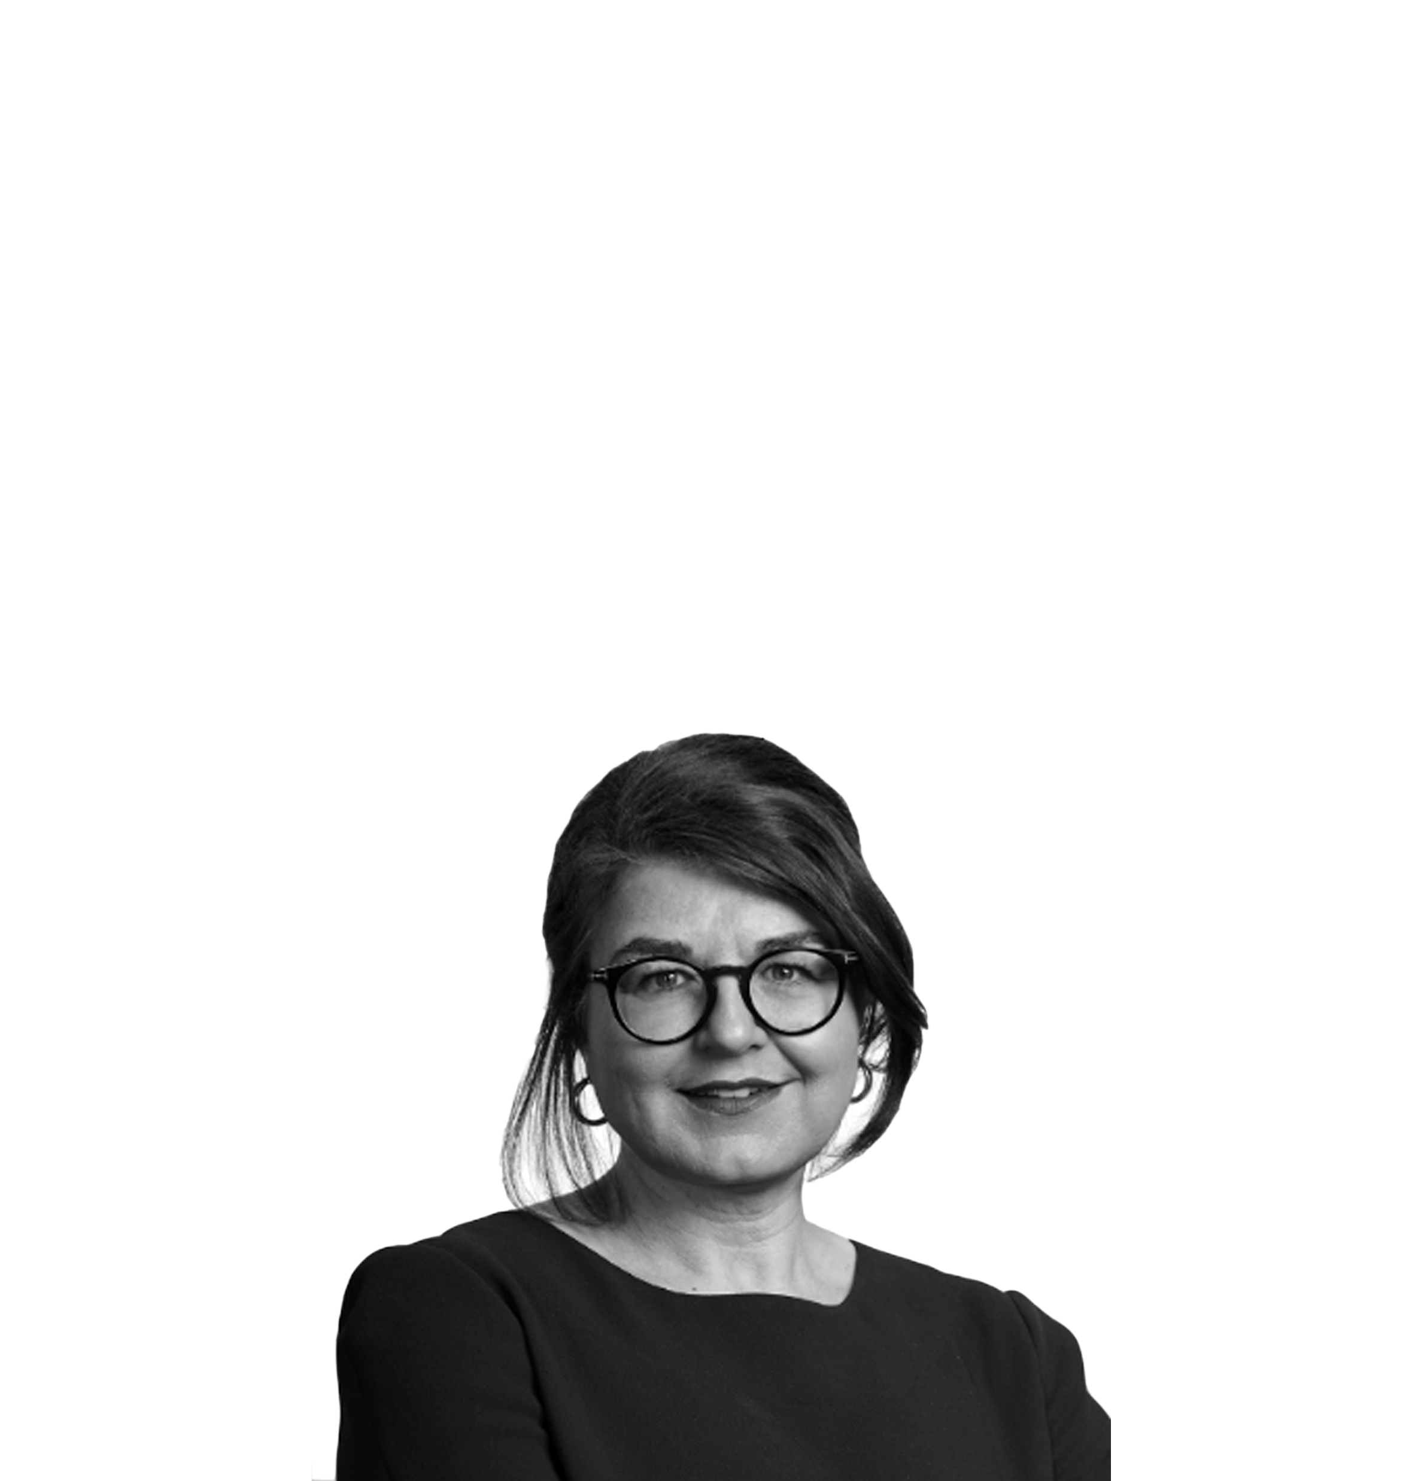
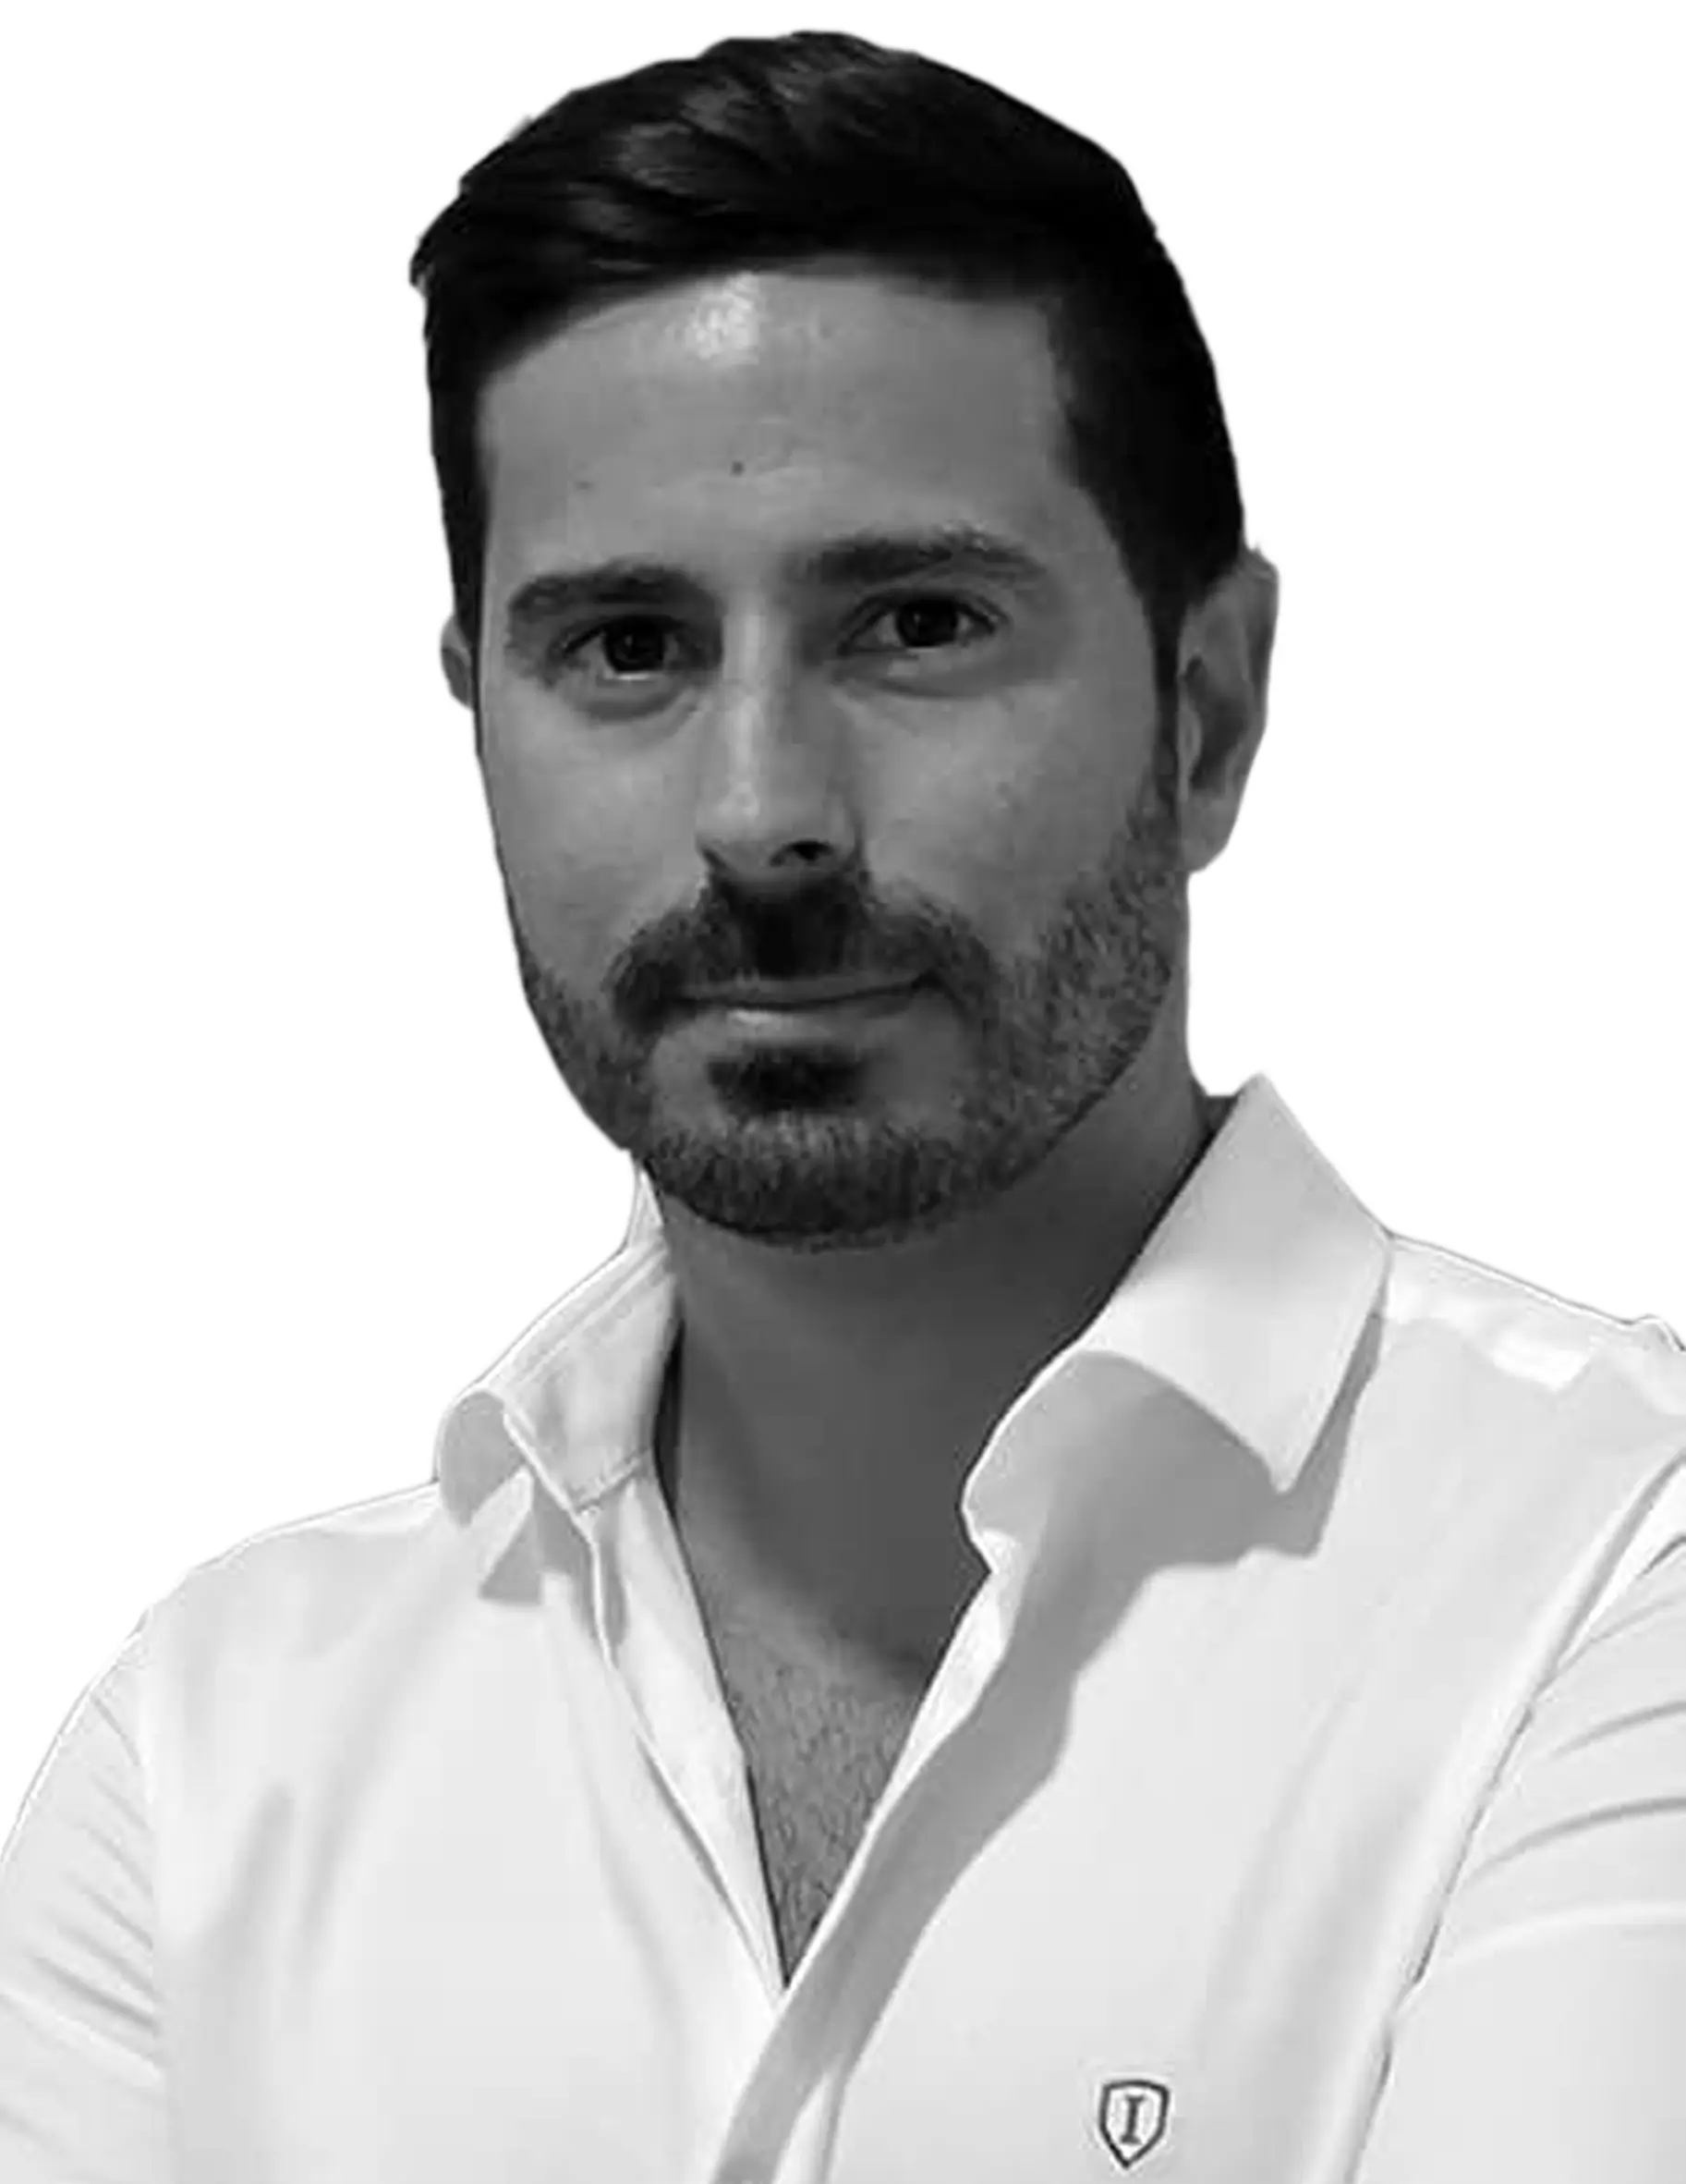
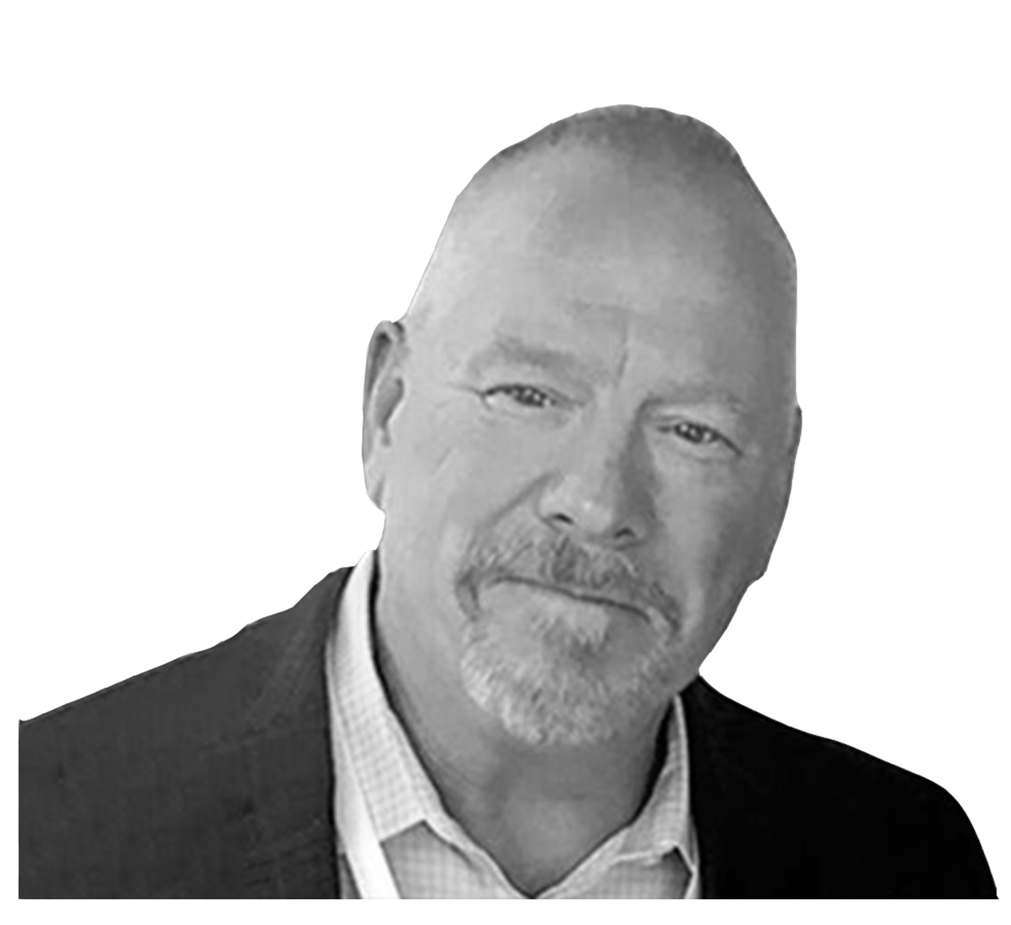
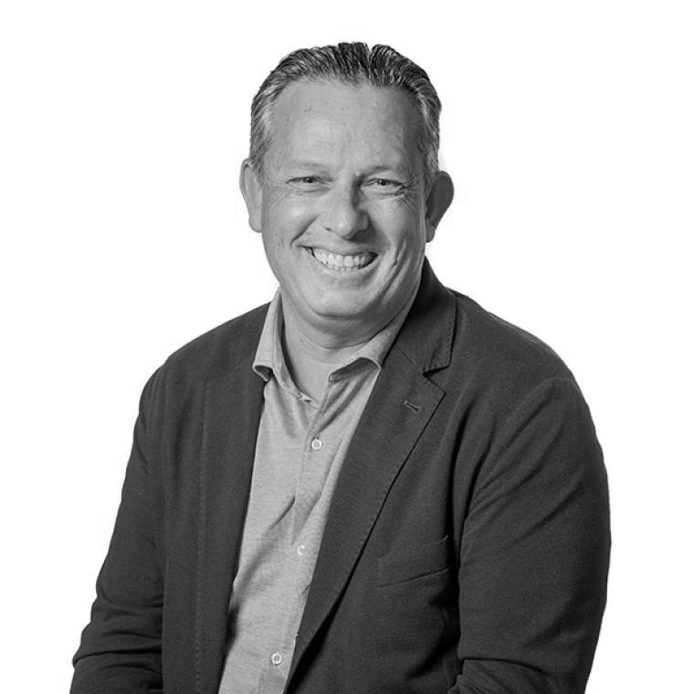
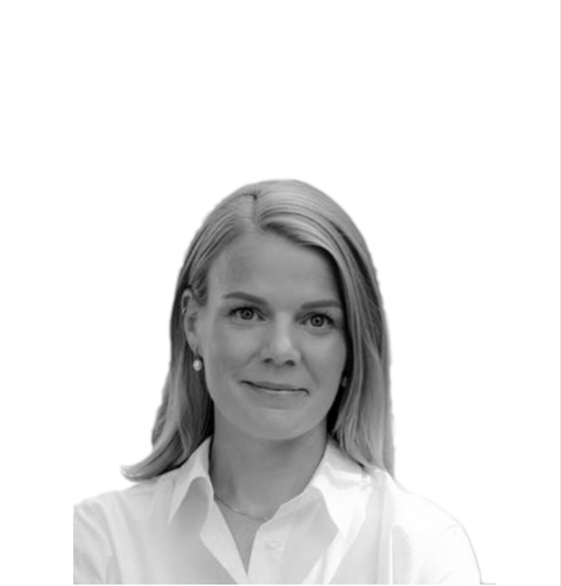
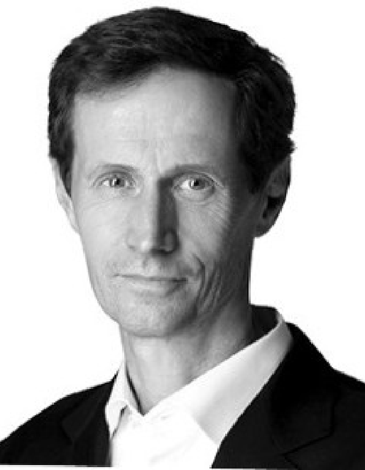
Speakers and topics
Stuart McMurdo
CEO, Accredited Insurance, Europe & UK
Olaf Jonda
CEO, DUAL Europe
Marc van der Veer
Managing Director Europe, Optio
Eva-Maria Barbosa
Partner, Clyde & Co
Rob Gibbs, President & CEO, SiriusPoint International
Darío Spata
President, ASASE
Erik Matson
Chairman, Bridgehaven Europe Specialty
Gabriella Engstrand
Head of Distribution, Europe, Accelerant
Elliot Richardson
Executive Chair, Howden Re
William Pitt, Executive Director, FASE

